Slide 1





Data Backup & IT Disaster Recovery Plan (DRP)
CIS 4350 - Group 5

Slide 2
Roadmap
Meeting with Murat to develop the narrative
We observed and recorded the test results
Developed a thorough IT Audit Report Data Backup
1
3
5
2
4
6
Developed a detailed ADG
Continued updating the ADG
Final edits of the whole project + submission
Notes:
Maham

Slide 3



Audit Team
Maham Rasheda
Iqra Malik
Genesis Cuadros

Slide 4
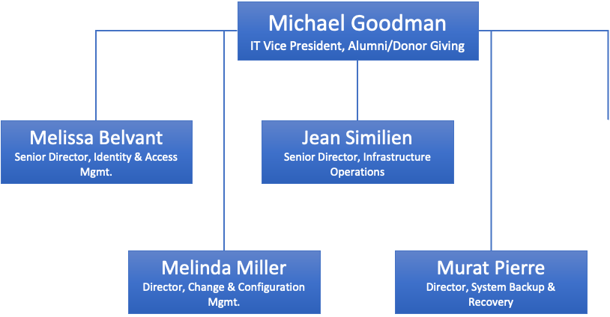

Notes:
Maham

Slide 5
Objective
The objective of this review is to assess the Data Backup & IT DRP process for the Alumni and Donor System (ADG).
Scope
The scope included the following areas:
Obtain an understanding of the data backup and IT DRP
Verify Data backup is configured
Verify that data backup is being monitored
Verify that Data backup has encryption
Verify that IT Disaster Recovery Plan is in place
Verify that there’s a business Impact Analysis
Verify that IT DRP testing is enabled
Verify that there is training personnel
Notes:
Maham

Slide 6
Narrative
Notes from Murat Pierre
Data Backup Configuration
Oracle Data Integrator
They are either backed up on a weekly or monthly basis, depending on the server being used.
Data Backup Monitoring
Tivoli, an IBM tool to back-up data.
User receives a warning messages alerts, and alarms via email = failure in backup
User will continue to troubleshoot
Data Backup Encryption
Data backups are not encrypted on premises
Encrypted on AWS cloud in a non-readable format.
Client uses TLS for encrypting data in transit and protecting data privacy.
IT Disaster Recovery Plan (DRP)
The client mentioned that they have no plan in place, but AWS does
There is a failure in identifying which systems need to be recovered.
Client doesn’t have proper training in place for staff. Data backups are not tested.
Notes:
Confiruguration & Monitoring: Genesis
Backup and DRP: Iqra

Slide 7
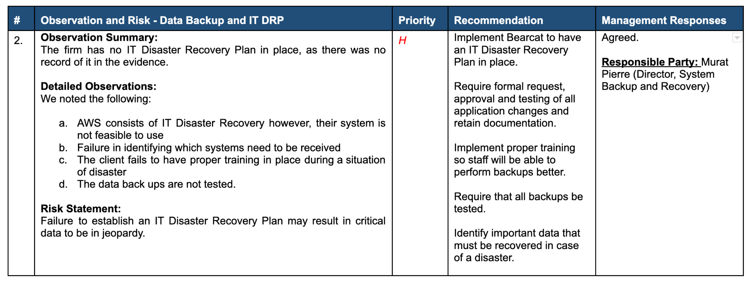
Notes:
SASLINUX - Maham
LANGRP - Genesis
AWS - Iqra

Slide 8
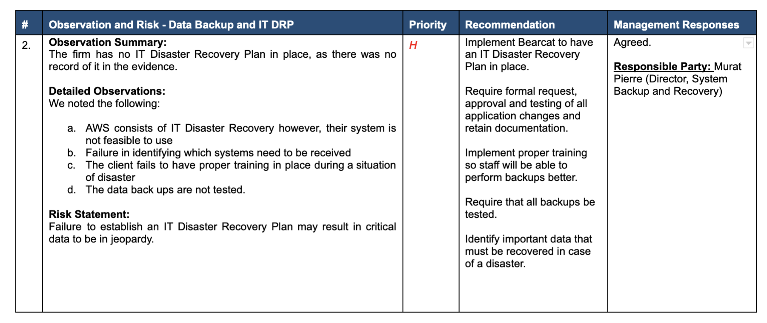

Slide 9
THANK YOU!!!!!!!

